Slide 1
Unit test & E2E test
Making test case use jest in Typescript

Slide 2
Menu
Introduce template Kaizen
Unit test by Jest
Apply jest test to make unit test and e2e test in NestJS

Slide 3
Start-kit Kaizen
GraphQL
https://github.com/vitalifyjp/Node_GraphQL_Backend_Template
Restful:
https://github.com/vitalifyjp/Node_Backend_Template
Base on NestJS

Slide 4
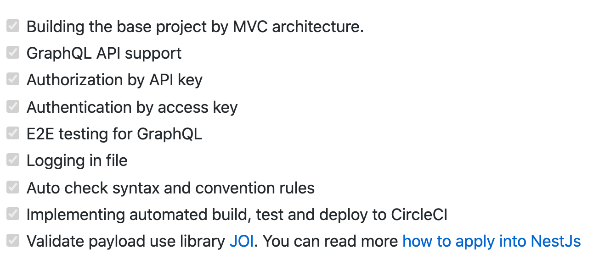
Start-kit template

Slide 5
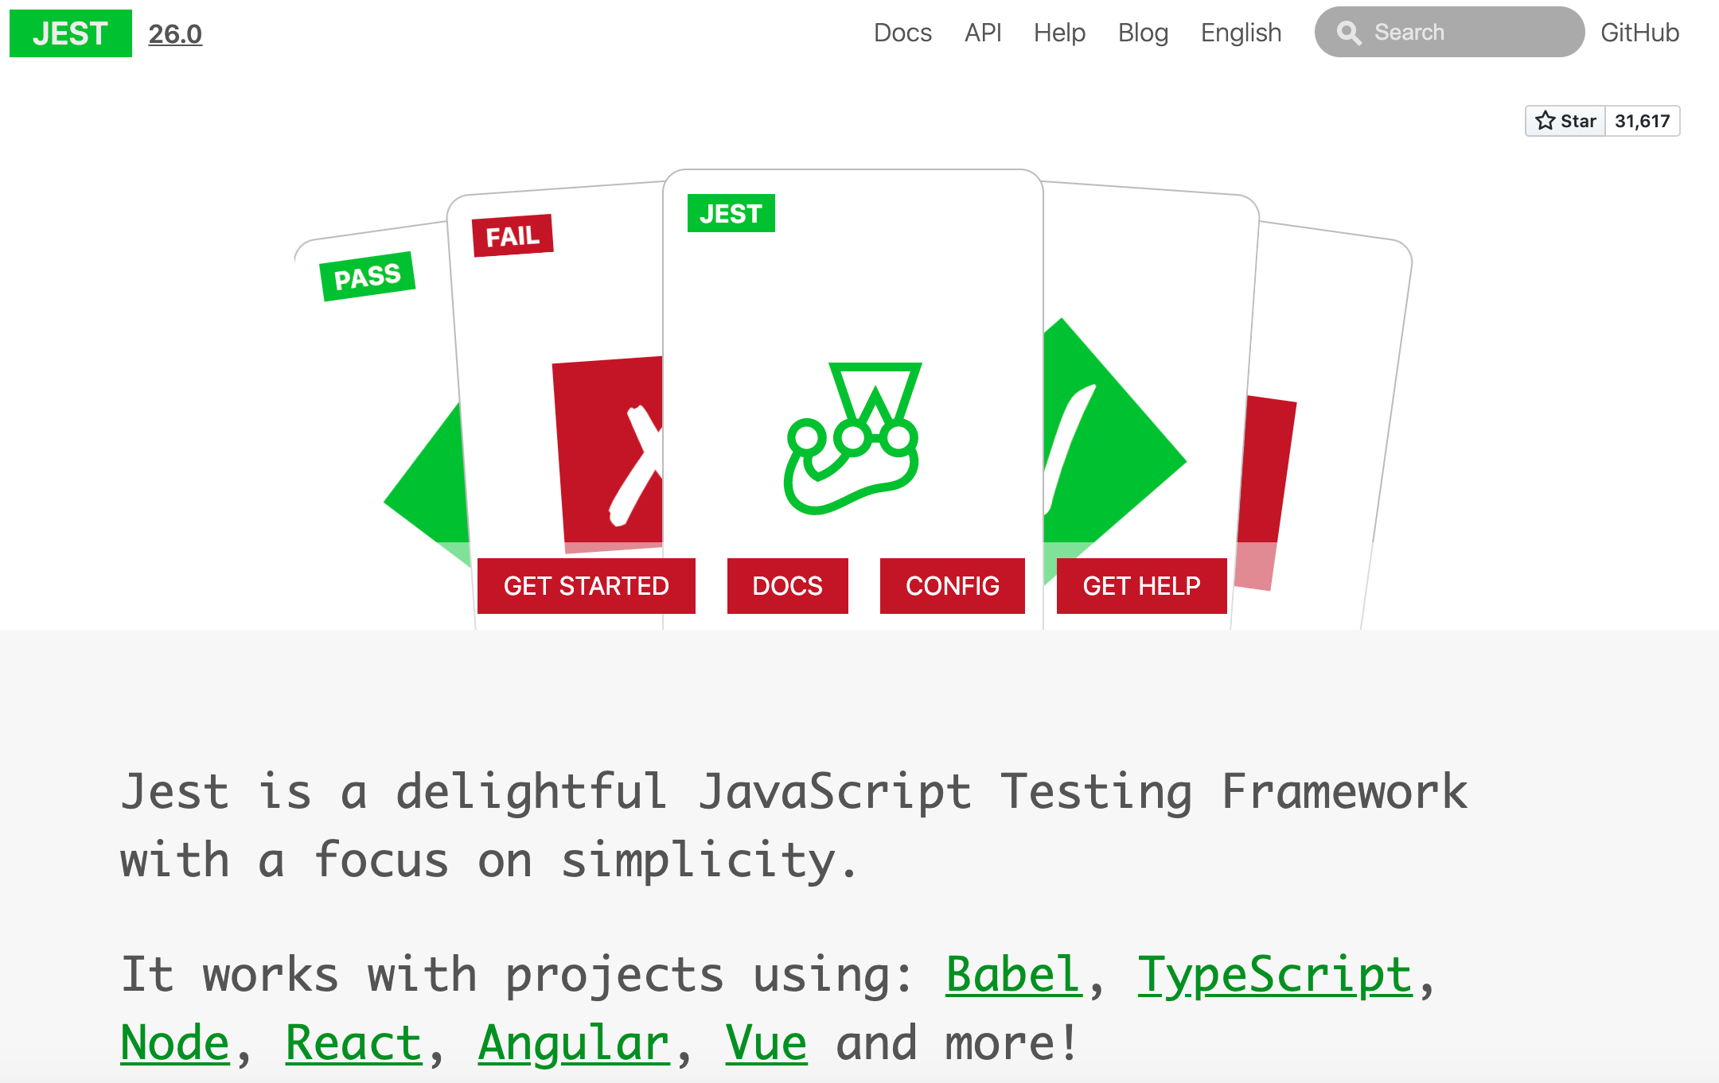
Jest
https://jestjs.io/
Concept & convention
Basic
Spy
Mock

Slide 6
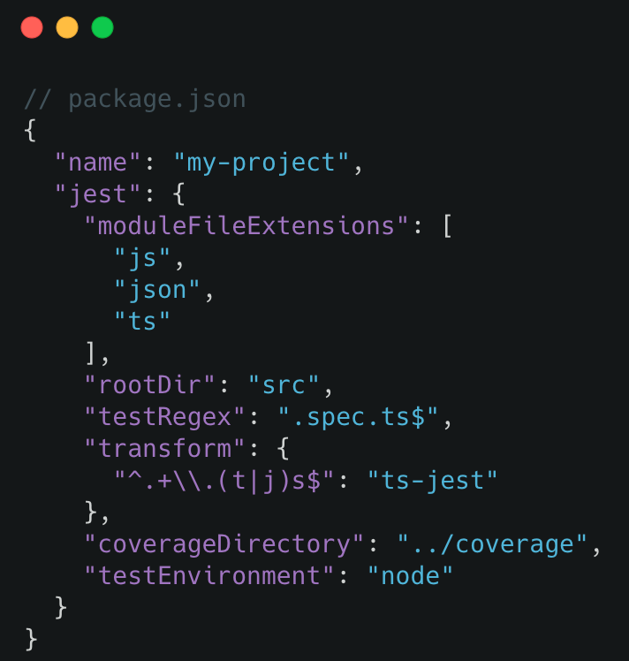
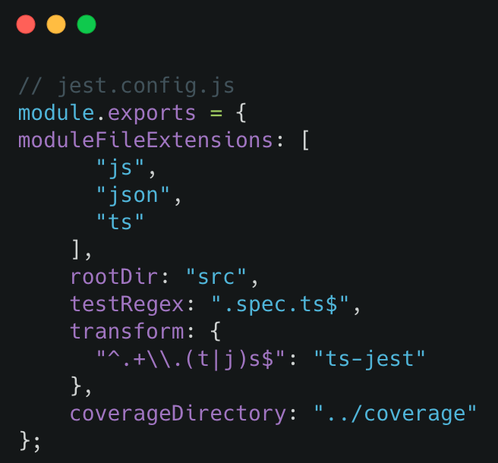
Configuring Jest
2 Way to put your own configuring jest

Slide 7
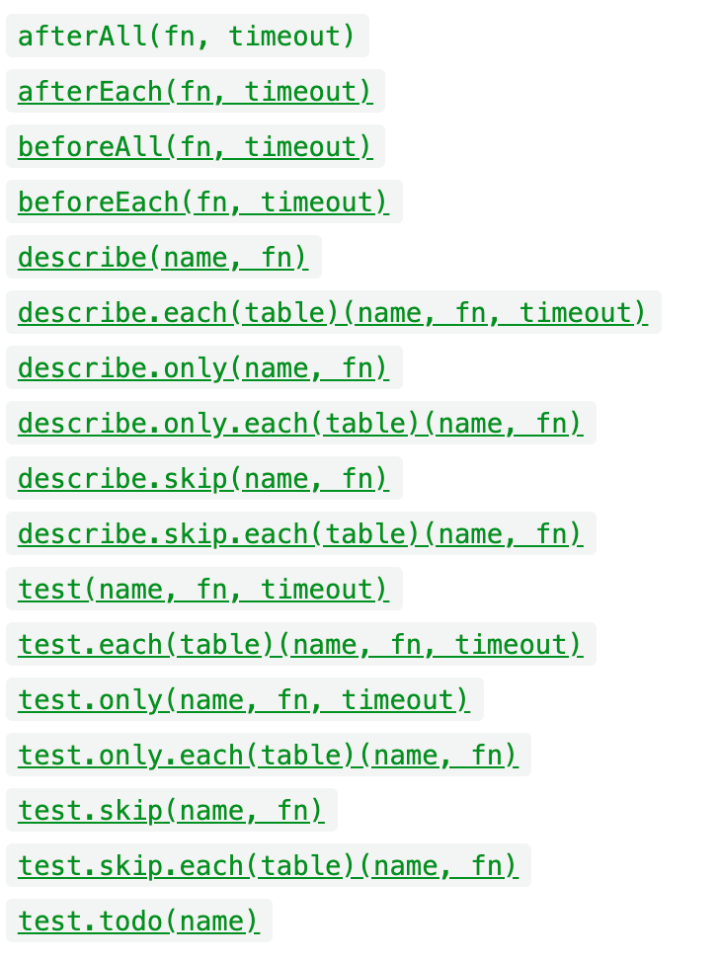
Global
Jest puts each of these methods and objects into the global environment. You don't have to require or import anything to use them

Slide 8
Mock & Spy
Both can be used to mock methods or fields
Mock functions allow you to test the links between code by erasing the actual implementation of a function, capturing calls to the function.
Two ways to mock functions: Either by creating a mock function to use in test code, or writing a manual mock to override a module dependency.

Slide 9
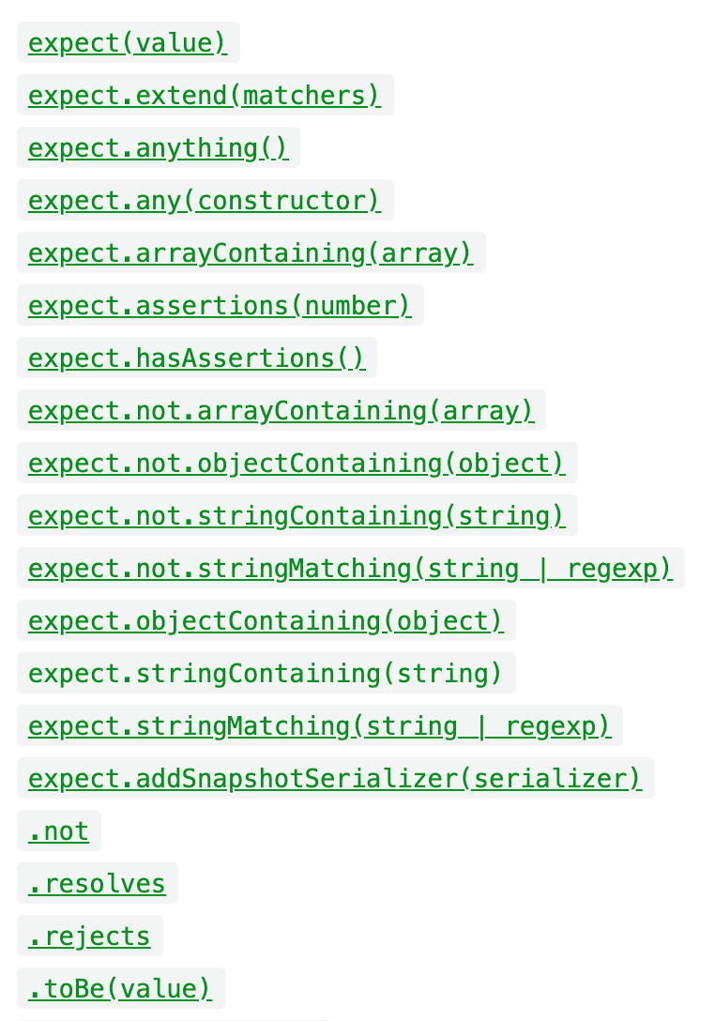
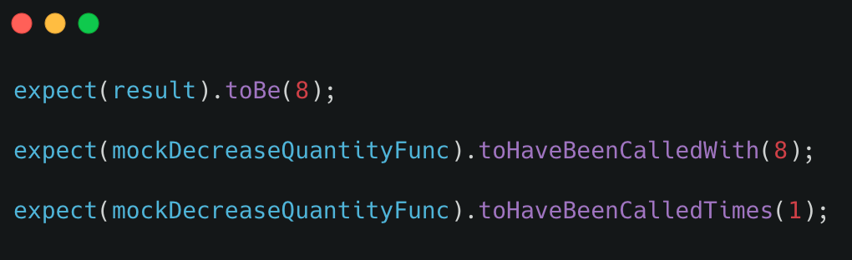
Expect
When you're writing tests, you often need to check that values meet certain conditions. expect gives you access to a number of "matchers" that let you validate different things.
https://jestjs.io/docs/en/expect
And more https://github.com/jest-community/jest-extended

Slide 10
AAA Pattern
Arrange
Act
Assert
Preparing
This might include instantiating the unit under test constructor, adding DB records, mocking/stubbing on objects and any other preparation code
Execute the unit under test
Ensure that the received value satisfies the expectation

Slide 11
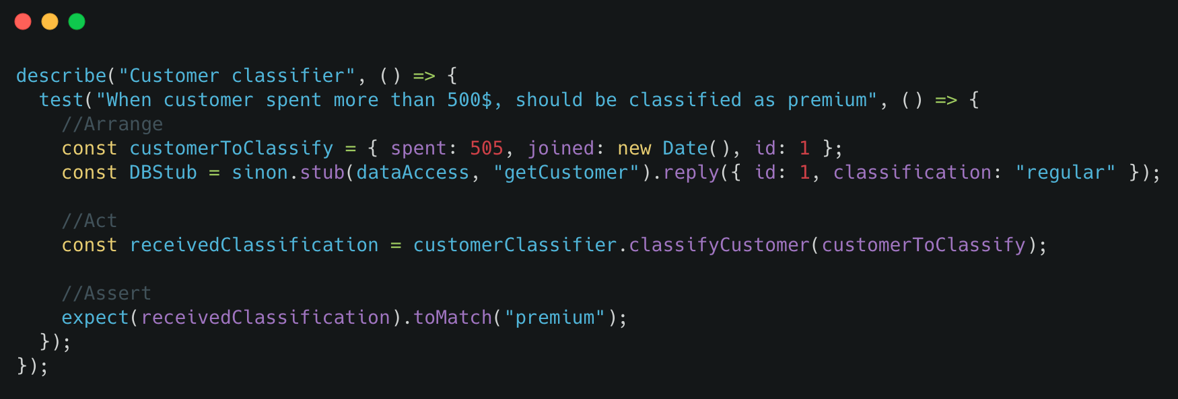
AAA Pattern

Slide 12
Practice
https://github.com/vfa-tunq/jest-demo

Slide 13
Q&A

